Slide 1
Week 3
Class relationships and Processing

Slide 2
Relationships
Relationships are how Objects interact with other Objects
Is there a strong connection between them, perhaps ownership over one, or a loose association with another object

Slide 3

Composition
Composition asks the question: What am I made out of?
These relationships are a “has-a” relationship.
Ex. A Person has Organs. A Building has Rooms
The dependents (Organs, Rooms) cannot exist without the class that “Owns” them
The owners of the object(Person, Building) are in charge of the creation and destruction of their dependent objects. Object can have a complete object or pointer to an object as a member.
A good way of picturing it is trying to imagine a room by itself. There is no such thing as a room without a building.

Slide 4

Aggregation
Aggregation asks the question: What do I have?
It is similar to Composition, however the “Owner” object isn’t in charge of creating it’s objects.
Ex. A Person has Clothes, A School has Students
Each object exists on their own. If a School object is Destroyed, the student objects still exist. Object can have a pointer to an object as a member.
A good way of picturing it is a shirt can exist by itself, but it will belong to a Person.

Slide 5

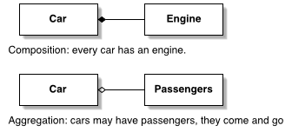
Aggregation Vs Composition

Slide 6

Association
Association asks the question: Who am I connected/affiliated to?
Associations have a loose connection. Each are in charge of their own creation and destruction.
Ex. Students are enrolled in a program, People have a favorite animal
This is similar to Aggregation, however each party doesn’t claim ownership over the other. Both objects involved exist in their own spaces but point to each other.
A way of picturing it is, I have a favorite team. If I stop existing my team remains. I don’t claim ownership of the team, but I affiliate myself with them.

Slide 7


Processing

Slide 8
Operator Precedence
All expressions fall under these 6 categories
Primary (variable name)
Postfix (x++)
Prefix (++x)
Unary (!)
Binary (x==y)
Ternary (x ? 1 : 2)

Slide 9
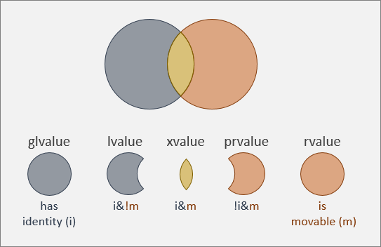
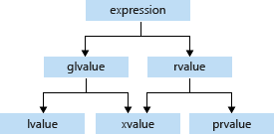
Value Category
Each expression is broken down into these categories
glvalue – evaluates an object or function
rvalue – Temporary object, or value not associated -------------------------------------------
xvalue - a glvalue that can be reused or moved.
lvalue – a value that is in memory and cannot be moved
prvalue – a value that can be used but is not in memory

Slide 10
Postfix Incrementation
This expression requires an lvalue before the ++
This operator can work with pointers.
Ex. Int i = 5; i++;
This operator returns an rvalue
if (c != c++){ //wait? Is this true??!?!?
std::cout << “Why are we learning c++ then?”;
}

Slide 11
Prefix Incrementation
This expression requires an lvalue and returns an lvalue.
This operator can work with pointers
int i = 5; ++i;

Slide 12
Logical Expressions
These expressions evaluate left to right. See ex.1
This differs from most Binary expressions that evaluate right to left. See ex.2
Ex.1 If (i == 5 || x==10) //i == 5 will check first if it is false it moves to x ==10
Ex.2 x = y + 5 // y + 5 must evaluate first before we can assign the value to x.

Slide 13
Order Matters
Remember that order matters when using expressions
Student& Student::operator=(Student* x){
if (x != nullptr && x->id > 5){
//this works if x is nullptr as it fails first before reaching the second condition
Student& Student::operator=(Student* x){
if (x->id > 5 && x != nullptr ){
//this will break your program if x is nullptr as it will try and access id but can’t reach it in memory

Slide 14
Expressions on different systems
Because hardware and software are different on different systems, don’t expect results to always be the same.
Things to consider:
Rounding up
Order of operations: int x = 3; x = x + ++x; //result might be 7 or 8.
Line endings
Threading symantics

Slide 15
Joke
How many programmers does it take to screw in a lightbulb?
0, it’s a hardware problem.

